Slide 2
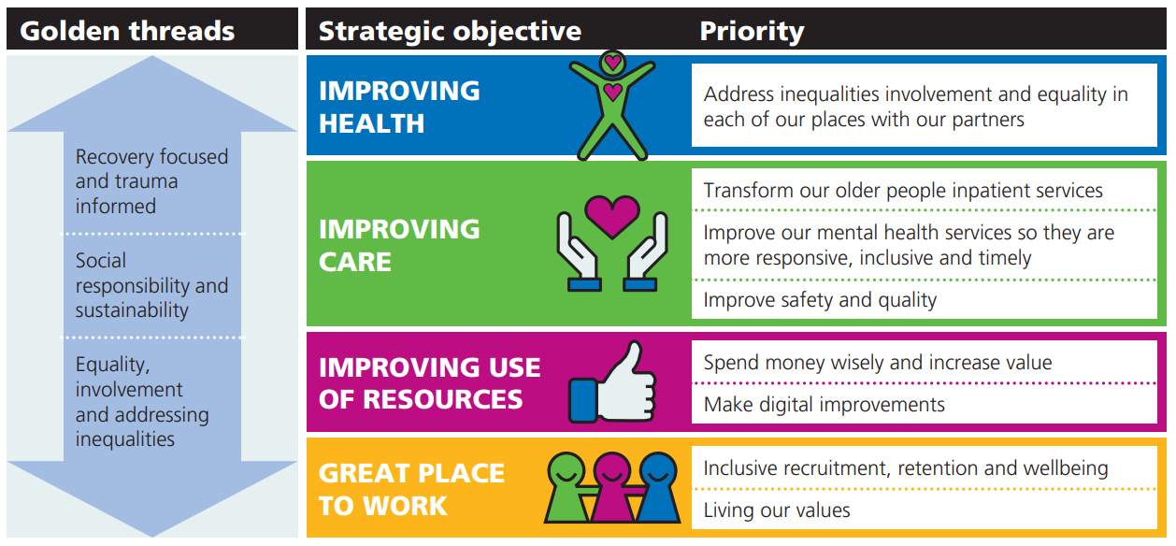
Our priorities for 2023-24
Social responsibility and sustainability: as part of our commitment to only procuring sustainable items, we have new guidance for services on purchasing of promotional items.
All of You – help us to ensure our services meet the needs of staff and service users by sharing your personal equality information and asking service users to do the same.
Improving health - Yorkshire and Humber community forensic CAMHS is now a specialised provider collaborative commissioning hub. We are the coordinating partner, and commissioning responsibilities have transitioned from NHS England to the West Yorkshire Specialised Provider Collaborative Commissioning Hub.

